Slide 1
ANGULAR Components and Directives Pipes, Dependency Injection
PRIYANKA SARODE
12-04-2022

Slide 2
Index
¡ Components and Directives
o Component Decorator
o Exporting components
o Templates and TemplateUrl
o Styles and styleUrls
o [Inputs] and [outputs]
o @Input and @Output
o Accessing elements using Reference (#ref)
o Defining events
§ Event target properties
o ng-template instead of template directive
o Custom Directives
o HostListener and HostBinding
Pipes
¡ Built-in pipes, json, slice,uppercase, lowercase, number, percent, currency, date, async, titleCase, Custom pipes
Dependency Injection
¡ Injecting on components
¡ Global injection on modules
¡ Providers
¡ Hierarchical injection

Slide 3
What Is a Dependency?
When module X in an application needs module Y to run, then module Y is a dependency of module X.
X
Y
Module X
Module Y

Slide 4
Dependency injection in Angular
Dependencies are services or objects that a class needs to perform its function. Dependency injection, or DI, is a design pattern in which a class requests dependencies from external sources rather than creating them.
Angular's DI framework provides dependencies to a class upon instantiation. Use Angular DI to increase flexibility and modularity in your applications.
Creating an injectable service
To generate a new class in the folder use the following Angular CLI command.
ng generate service serviceName

Slide 5
Dependency injection in Angular
Dependency Injection is a powerful pattern for managing code dependencies. DI is a way to create objects that depend upon other objects.
Angular has its own DI framework pattern, and you really can't build an Angular application without Dependency injection (DI).
A DI system supplies the dependent objects when it creates an instance of an object.
Let us take an example of a CAR. The CAR consists of following things –
Engine
Tires

Slide 6
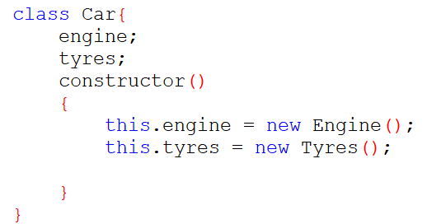
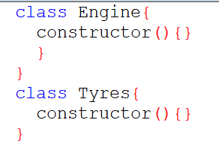
Need Dependency injection in Angular

Slide 7
Service
A class with specific purpose :
Share Data
Implementation application logic
External Interaction
Naming convention - .service.ts

Slide 8
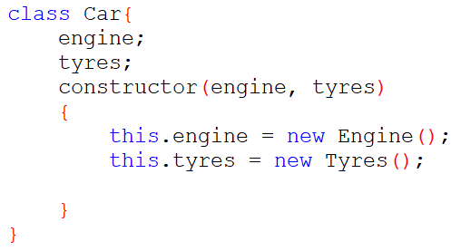
DI as Design Pattern
DI is an application design pattern and you really cannot build an Angular application without dependency injection (DI).
Without DI
With DI

Slide 9
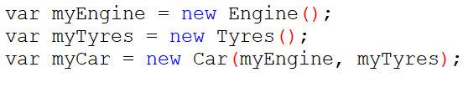
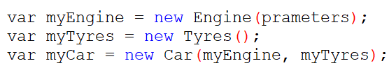

DI as Design Pattern

Slide 10
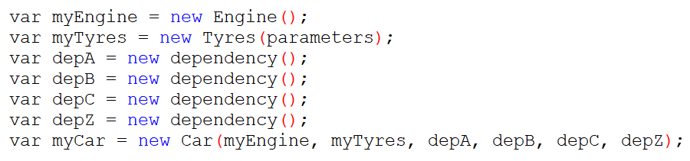
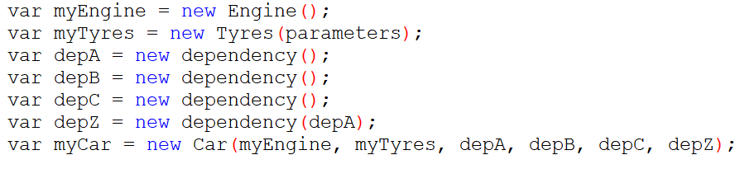
DI as Design Pattern

Slide 11
DI as a framework
Injector
Engines
Tyres
DepA
DepB
..
..
..
..
DepZ
ServiceA
ServiceB
ServiceC
..
..
..
..
..
..
ServiceZ
CAR
EmpList

Slide 12
DI as a framework
Define EmployeeService class
Register with Injector
Declare as dependency in EmpList and EmpDetails
EmployeeService
EmpList
EmpDetails

Slide 13
Hierarchical DI in Angular
Register
AppModule
Register
AppComponent
Register
EmpList
EmpDetails
Child1
Child2

Slide 14
Practical Demo
Project Name : AngularDI-ServiceDemo

Slide 15
Thank You

